Slide 1

Flight delay and Reason Prediction
Anirrudh Venkataraman, Divyaa Thellore Venkataraman, Sadab Qureshi

Slide 2
Introduction
Intent of the Project:
To find the flight delay
To find the reason for the flight delay
Objective:
Applying the right preprocessing on the data
Choosing the right algorithms based on the data to predict the delay and the reason
Dividing the dataset to train and test
Find the metrics and the accuracy based on that.

Slide 3
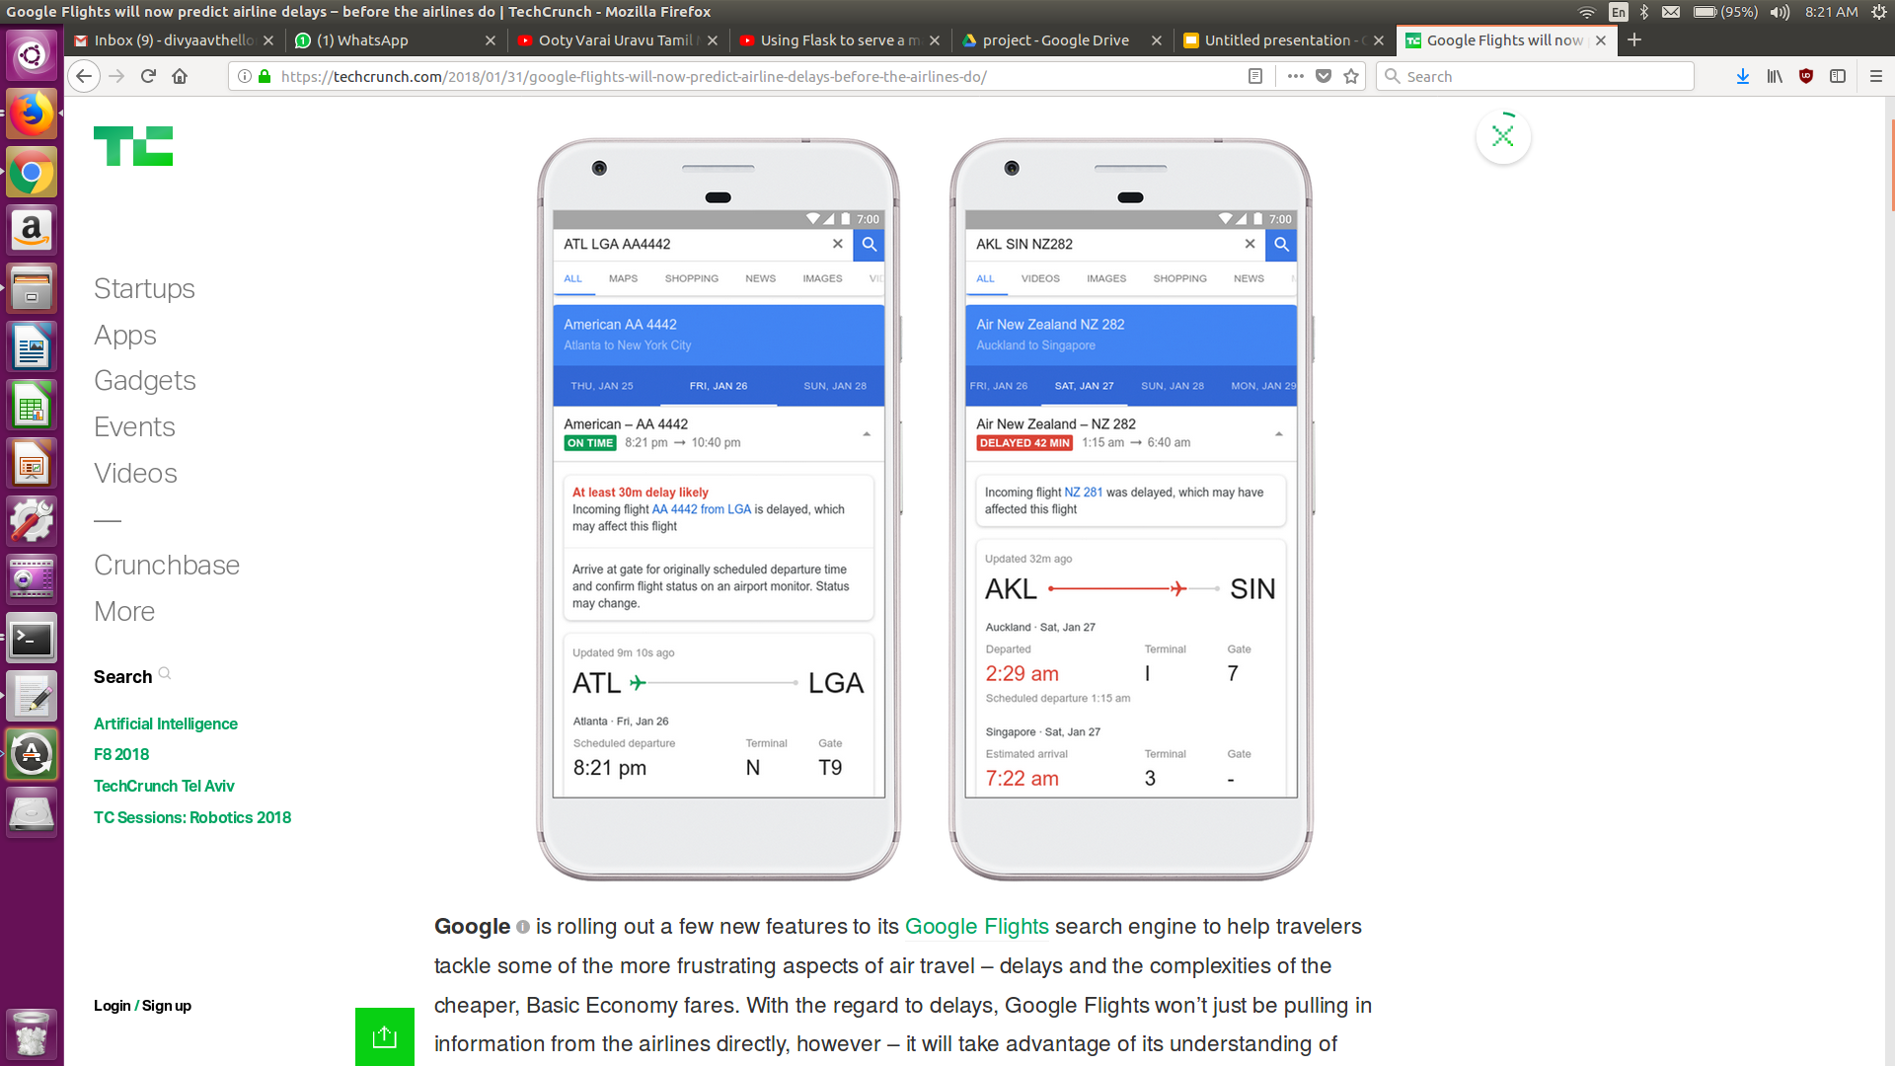
In the Market
Google has updated Flights app with two new features:
-> Flight delay time
It uses machine learning to predict upcoming flight delays

Slide 4
Algorithms
The algorithm chosen to use should be based on the dataset. From this dataset we chose to use the following data mining algorithms:
Linear Regression
Ridge Regression
Lasso Regression
Random Forest

Slide 5



Technologies and Tools Used
Jupyter Notebook
Python 2.7
Flask Framework
Dataset (available online)

Slide 6
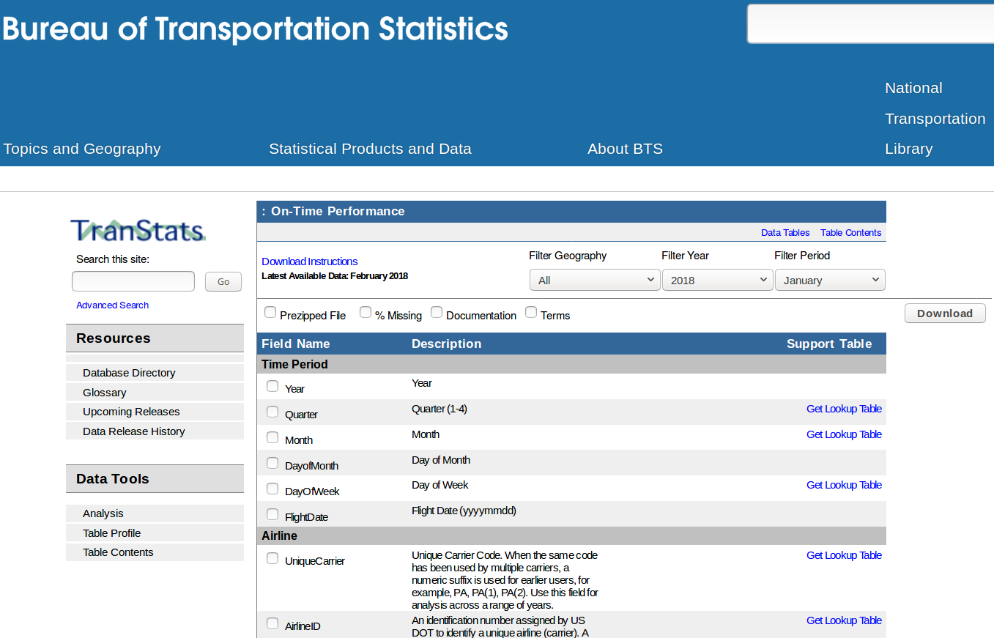
Dataset Used
Source : https://www.transtats.bts.gov/DL_SelectFields.asp?Table_ID=236
Size :
Some of the fields:

Slide 7
Methodology Followed
Preprocessing on the Data
Choosing the appropriate Dimensions
Filling the empty values in the dataset
Creating train and test dataset
Choosing what techniques to apply
Finding the metrics to calculate the metrics

Slide 8
Module -1 - Delay Prediction
The dataset is loaded
Encode the labels of those columns that have string values
Find the correlation to see how ‘ARR_DELAY’ is correlated to all the other attributes.
Drop all unwanted or un correlated attributes
Using “OneHotEncoder” to give values to label encoder.
Creating new list of fields with all the required fields and the encoded labels
Applied Linear, Ridge , Random Forest, Lasso regression techniques that issued the following results.

Slide 9
Analysis of Results - Module1
Module | Technique | Observation
For flight delay prediction | Linear Regression | Mean Absolute Error - 8.00 root mean square - 11.3120800394 Mean squared error - 127.96
For flight delay prediction | Ridge Regression | Mean Absolute Error - 8.00 root mean square - 11.3119565739 Mean squared error - 127.96
For flight delay prediction | Random Forest | Mean Absolute Error - 0.23 root mean square - 0.2855076068 Mean squared error - 0.08
For flight delay prediction | Lasso Regression | Mean Absolute Error - 0.23 root mean square - 0.2855076068 Mean squared error - 0.08

Slide 10
Module -2 - Reason for Delay Prediction
The dataset is loaded and remove those entries without delays
There are 5 reasons that can lead to a flight delay
The delay in flight can be due to a single reason or due to combination of reasons. The delay reason can also be due to some other reason.
Correlation between the delays each reason and all the other attributes are found and are stored in a separate data frame.
For those attributes that have good correlation but do not have values in a specific row those are filled with mean values.
Repeat the same for all the reason data frames
Applied Linear Regression and ridge regression techniques thta gave the following result

Slide 11
Analysis of Results - Module 2
Module | Technique | Observation
Delay Reason Prediction | Linear Regression | Rms - 6.844
Delay Reason Prediction | Ridge Regression | Rms - 6.8

Slide 12
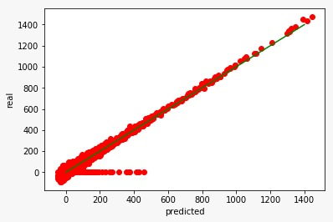
Graphs
Linear Regression for Delay Prediction

Slide 13
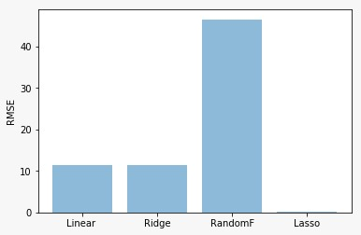
Graphs (cont.)
Comparison of regression models in delay prediction

Slide 14
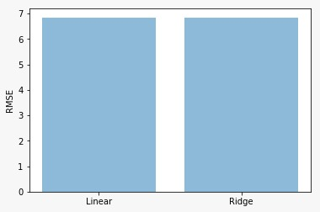
Graphs (cont.)
Comparison of the regression models for reason prediction

Slide 15
Decisions Made
Difficulties Faced
Choosing which project to work on
What modules will be included
What preprocessing techniques to be applied
What models to be tested
What metrics to be chosen to evaluate the results
How to deal with the fields with empty values
To ignore the empty values (which was nearly 80% of the database)- which will lead to high approximation
To fill the values in the empty fields using regression techniques from those values that were present in the database.

Slide 16

Things that worked and did not work
Conclusion
Filling the empty values with values improved the accuracy | it took a long time for us to decide how to deal with the missing values
Filling the empty values with values improved the accuracy
Eliminating the outliers improved the model
Preprocessing applied depends on the dataset
It is based on the dataset that we choose what algorithms to apply
Using metrics to choose the best model for the dataset is very effective
There is dependency between the various reasons for flight delay

Slide 17

Project Plan / Task Distribution
For the time that we had , we sat together and worked as a team
Made easy to make decisions
It worked well when we got stuck. We could solve the issue by thinking together

